Slide 1

ONLINE COMPANY EXPENSE RECORDING WEBSITE BASED ON MULTI-COMPANY
Brevalda Resnu Putra Kaltanda
218180412
S1 – system information and bussiness

Slide 2
What Is Multi Company ?

Slide 3
What is Multi Company?
A multi-company is a company that owns two or more other companies. Generally, this type of company operates in different industries and has one parent company, referred to as a holding company. A multi-company also has different locations.

Slide 4
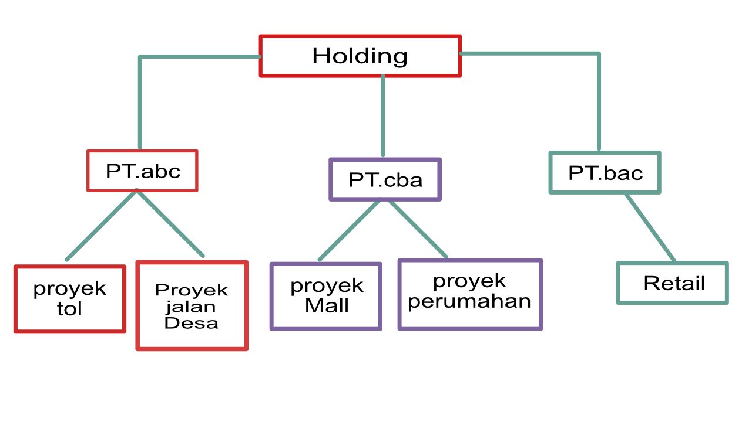

Slide 5
What’s The benefit ?

Slide 6
Benefit
Risk Diversification
By owning several companies operating in different sectors, business risks can be more diversified. If one company experiences a performance decline, the businesses in other sectors can continue to perform well and balance the overall performance.

Slide 7
Benefit
Operational Efficiency
A holding company can help improve efficiency by centralizing certain functions, such as accounting and finance. This can reduce operational costs and enhance synergy between companies within the group.

Slide 8
But there is problems

Slide 9
Problems
these type of business relationships are often overshadowed by trust issues, particularly concerning financial aspects, Especially their expenses.

Slide 10
Problems
Trust issues in the context of finance between these companies can affect the stability, growth, and sustainability of their business collaborations.

Slide 11
What are examples of expenses that can cause trust issues in a multi-company?

Slide 12
Expenses
- employee salaries
- project operational costs
- Miscellaneous expense (repair, natural disasters etc)
- Personal Expenses for the company executive

Slide 13
Solutions?

Slide 14
Solutions
We need a website that has 3 roles, namely a transaction recorder, an approver, and an admin. A transaction recorder is a user who inputs transaction data on the website, an approver is the audit team that monitors the transactions, and an admin is a user who can register new data to be used by other users or register new companies.

Slide 15
Solutions
We need a website that can record various types of entries such as employee salaries, miscellaneous expenses, personal expenses, and project operational costs that can have budget limits.

Slide 16
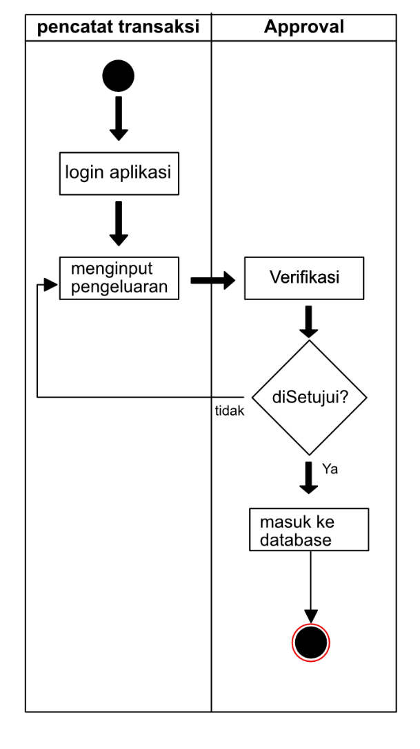

Slide 17
comparison
 | My website | Accurate 5 | Microsoft dynamics nav
scalability | Yes | No | Yes
Cloud storage | Yes | No | Yes
Multi platform | Yes | No | No
Price | 20 million per year | 35 million / 5 license | 31.2million / year

Slide 18
Main Feature
1.Employee Salaries
2.Account Records
3.Future Records
4.Project Operational Costs
5.Personal Expenses
6.Miscellaneous Expenses
7.Non-budgeted Operational Costs
8.Operational Reports
9.Project Operational Reports
10.Personal Expense Reports
11.Miscellaneous Expense Reports
12.Overall Reports

Slide 19
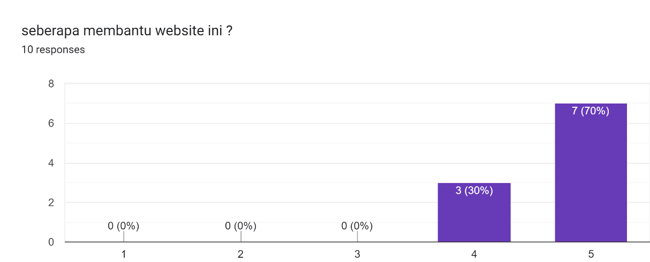
Testing, How helpful this website?

Slide 20
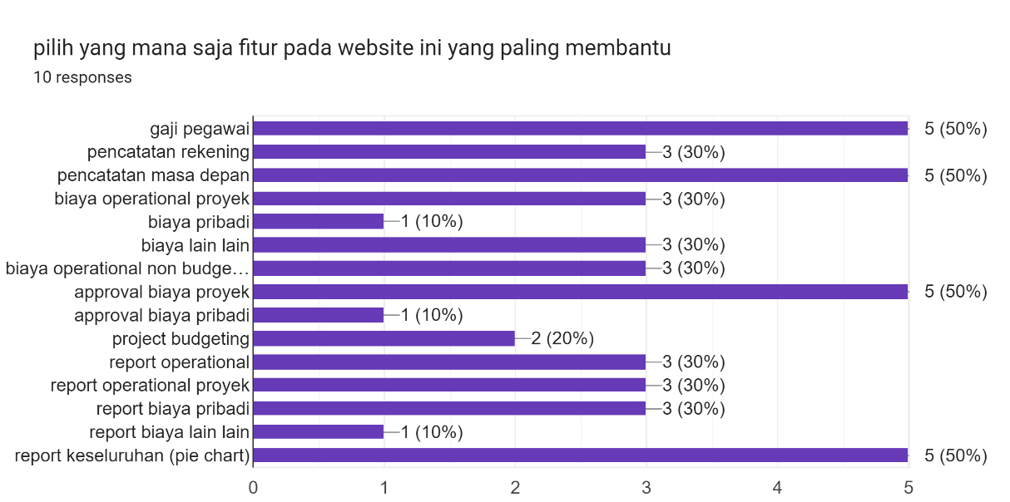
Which features are most helpful?
Notes:
Employee salary. Future records,approval transaction project ,overall report

Slide 21
feedback
1. All inputs related to approval should not be editable to avoid data manipulation.(M.izzan fahrozi – Muhammadiyah organization sidoarjo)
2. The layout for printing PDF reports, especially those related to calculations, should be placed at least on the right side. (Syaiful Wildani – PT.pelni(Persero)
3. Project cost details issued by other companies should be accessible for input across the entire company. (Naufal Rahman PT. Reka nusa pracipta consultindo)
4. The pie chart on the printable report should ideally be written with one pie chart per page to make it easier to read. (Diky ariyanto - PT. albani corona Lestari)

Slide 22
Solutions
1. We delete all edit button and function at at detail project reporting and personal expenses
2. we put the layout especially who have countable value on right side
3. We removed the data selection that could filter the company codes owned by the user.
4. We changed the pie chart layout to one layout per page.

Slide 23
Conclusion
This website can assist users, especially companies with a multi-company structure. However, it can also function well for businesses with branches or even non-profit organizations with one or more other departments. And The features of this website that users find most useful, based on the highest survey results, include employee salaries, future cost recording, project cost approval, and overall reporting.

Slide 24
Thank you
Brevalda Resnu Putra Kaltanda
218180412
S1 – system information and bussiness

